Slide 1
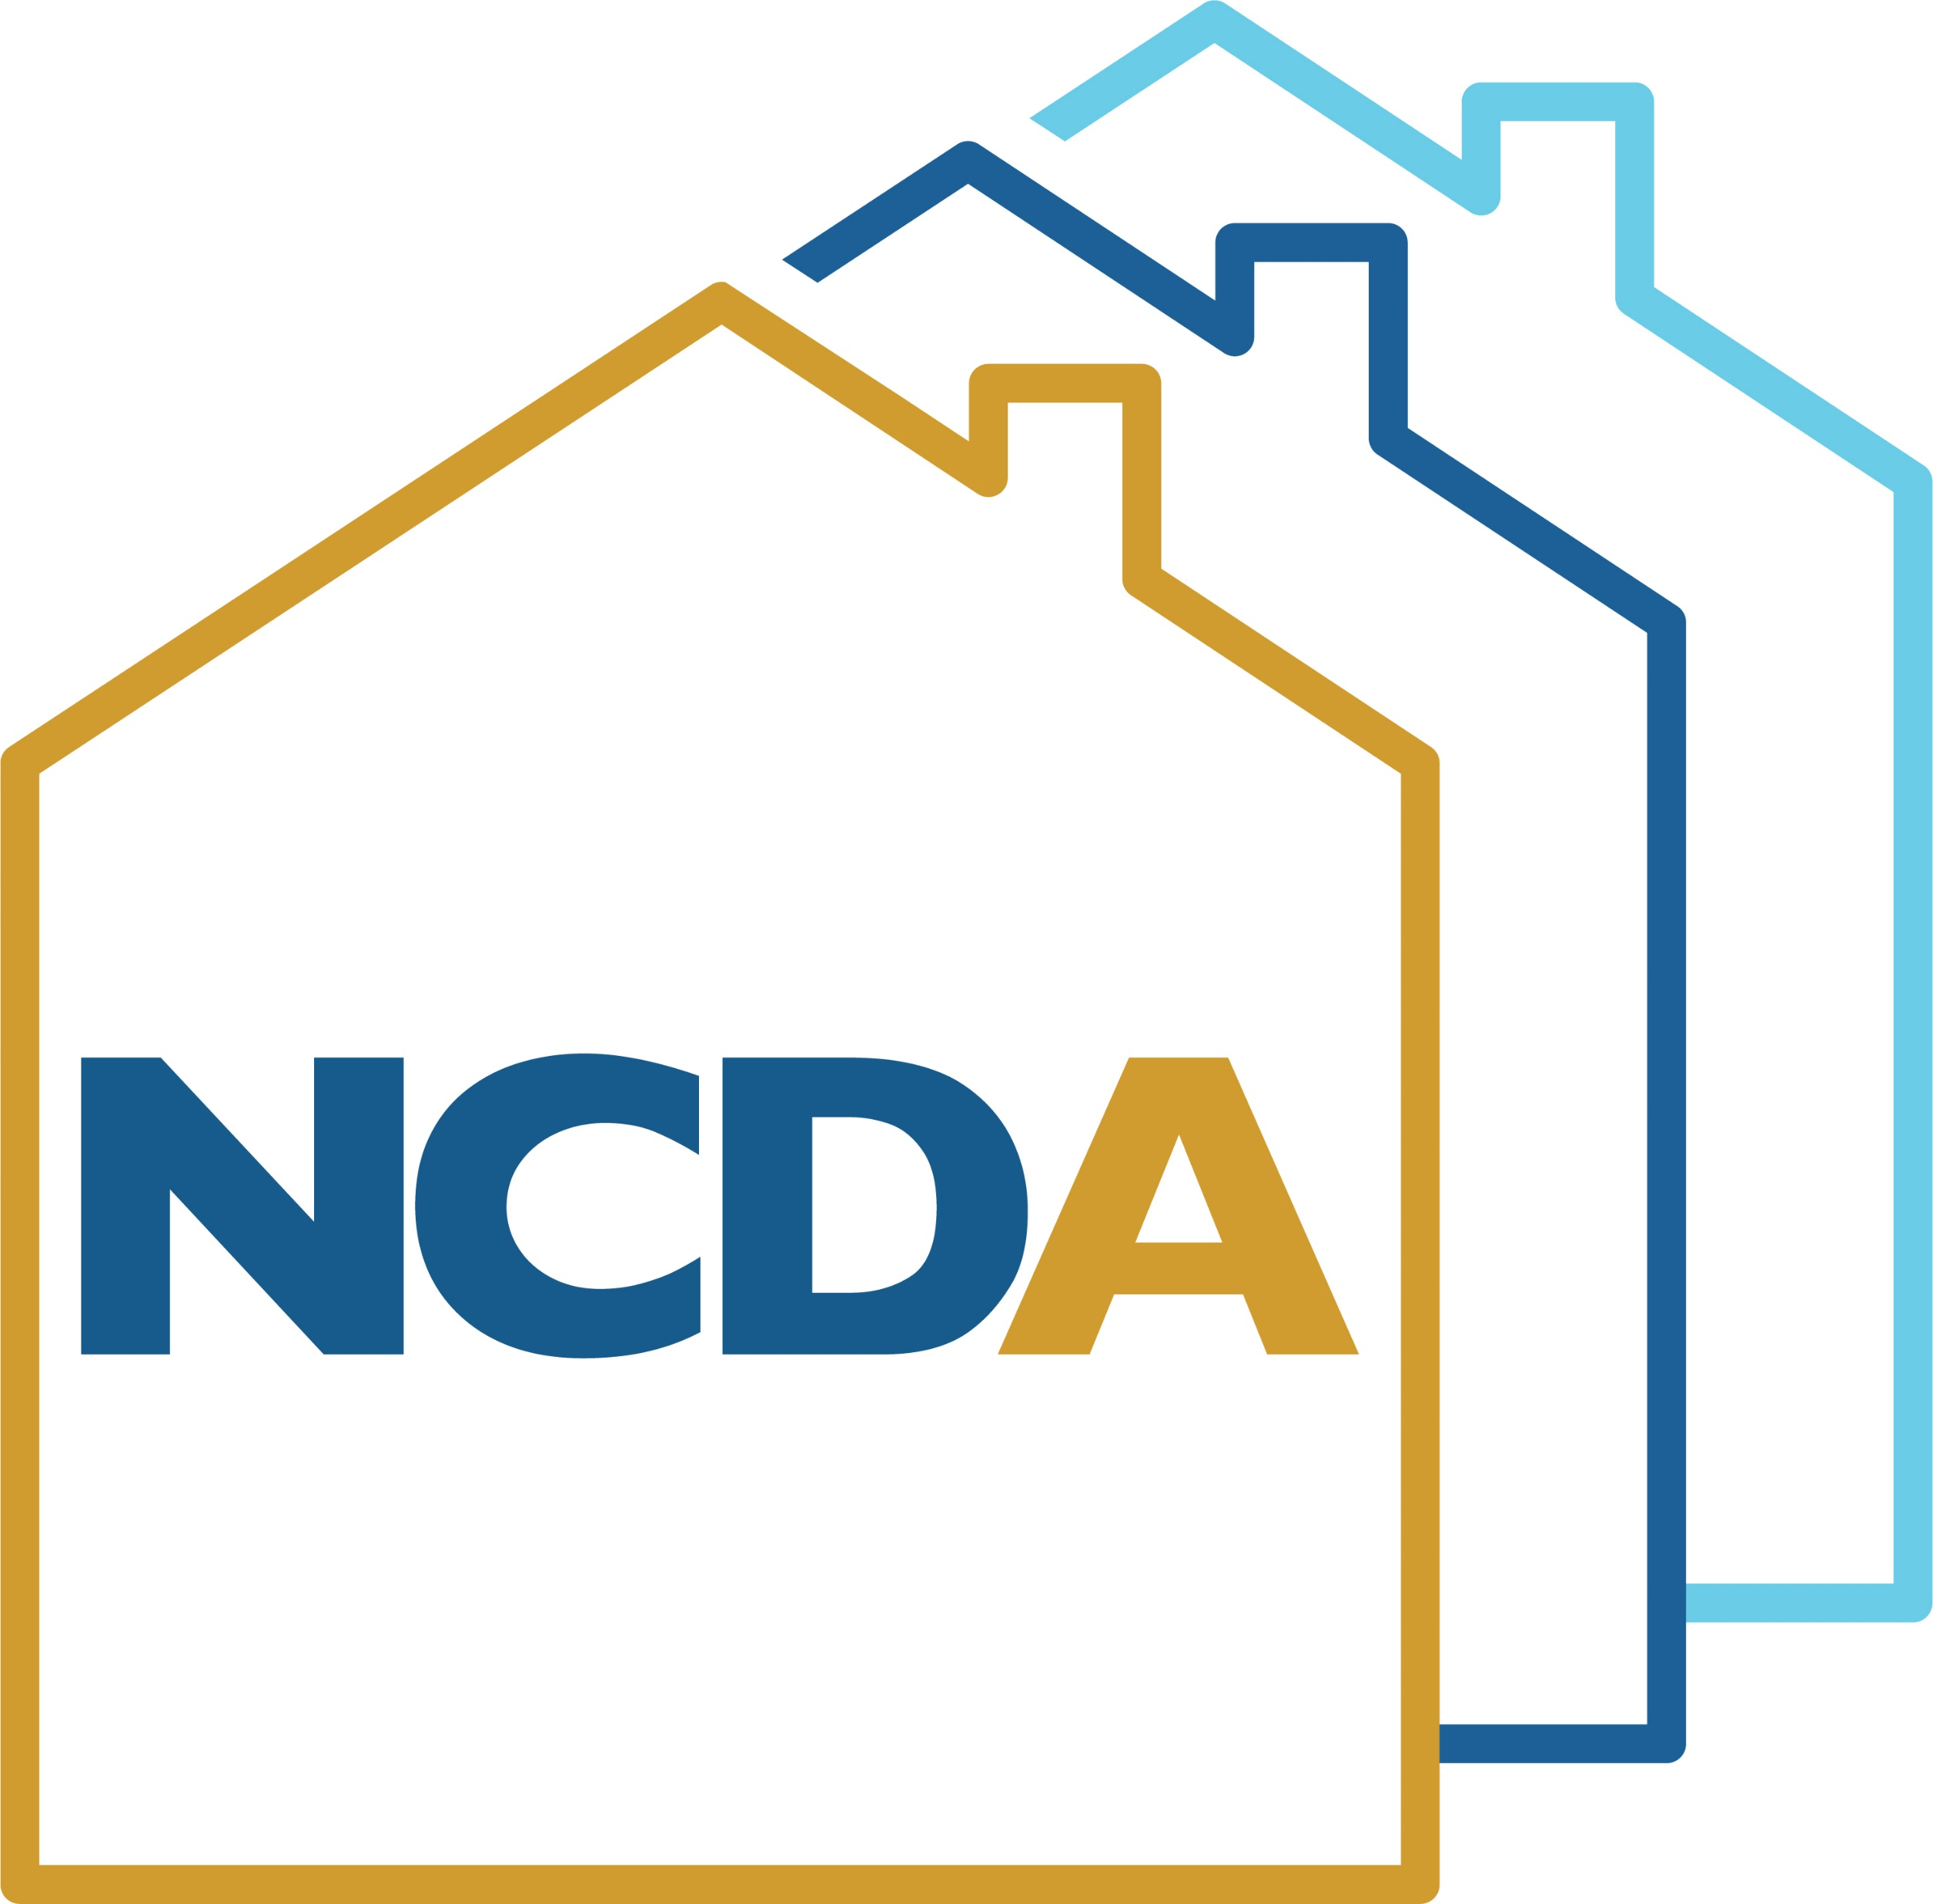
Using Federal Funds to Attract Housing Investments
NCDA Annual Conference
June 22-24, 2022

Slide 2
Speaker
Hans Mach
Community Development Administrator
McHenry County, IL
hdmach@mchenrycountyil.gov

Slide 3
Programs Managed by Community Development
Community Development Block Grant Program
HOME Investment Partnerships Program
Continuum of Care Program – HMIS Lead
Continuum of Care – Unified Funding Agency
Continuum of Care – Collaborative Applicant
Lead Safe Homes Program
Treasury – Emergency Rental Assistance Program (McEURAP)
Senior Services Grant Program
Emergency Food and Shelter Program
Emergency Solutions Grant – CV Funds

Slide 4
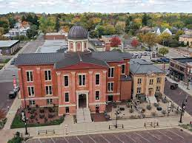
How did we decide on affordable housing?

Slide 5
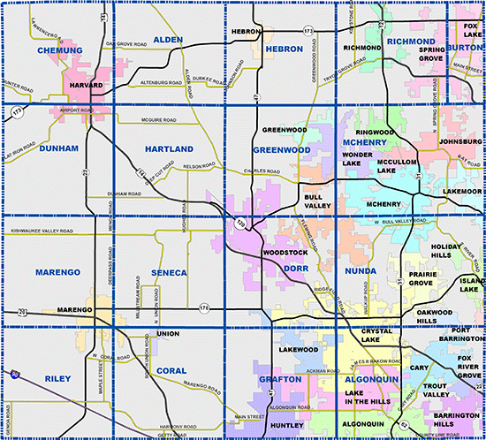
About McHenry County
Population: 310,229 (2020)
Flat Population: 308,760 (2010)
Urban, Suburban, Exurban Areas
113,269 households
80.1% Homeownership Rate
Exception Criteria 44.61% for Low-Mod Area Benefit

Slide 6
About McHenry County
$90,014 AMI for Family of 4
603.17 square miles
5 cities, 25 Villages, 17 TWP
Transportation is a challenge
METRA to Chicago available

Slide 7
McHenry County Housing Market
Census indicates $234,000 avg.
Average mortgage of $1,904
High property taxes
Seven units have sold over past 60 days; average $234,714
81.2% homeowner rate in 2015 (dropped after housing bubble)

Slide 8
McHenry County Rental Market Market
Census indicates $1,200 Median
Need to earn $48,000/yr. + to afford
State Median: $1,038
Housing cost burden is major problem

Slide 9

Evaluation of the Four Housing Problems
Lacks kitchen facilities
Lacks complete plumbing
Overcrowding
Cost burden of 30% or more

Slide 10
Evaluation of Data: Why was affordable housing the way to go? (NA-10 in Con Plan)
484 units in total lacked plumbing or proper kitchen facilities
These units are most commonly former summer cottages in McHenry County
0.43% of the total housing stock is affected
Funds could be diverted from HOME to CDBG to address these units
Some units are likely abandoned
1,322 units are overcrowded
In McHenry County, these are likely to be SFH conversions
1.17% of the total housing stock is affected
Typically counted with “Category 3 homeless”
Newer or more affordable housing stock would benefit by potentially reducing household size

Slide 11
Evaluation of Data: Why was affordable housing the way to go? (NA-10 in Con Plan)
26,137 units are affected by cost burden of over 30% - 23% of the County’s households
This affects both renters and homeowners
35% of the affected are renters and 65% homeowners, which suggests underwriting of homebuying (rates do not match unit distribution)
Housing stock sells/rents very quickly; low vacancy rates
13,276 units are affected by cost burden of over 50% - 11.7% of the County’s households!
This affects both renters and homeowners
34% of the affected are renters and 66% homeowners, which suggests underwriting of homebuying (rates do not match unit distribution)
Of the 4,545 renter households at 50% CB, 3,011 are 30% or less AMI

Slide 12
At-risk populations
Of the 4,545 renter households at 50% Cost Burden, 3,011 are 30% or less AMI
In the Consolidated Plan evaluation, the County correctly predicted a Qualifying Population for HOME-American Recovery Plan Act funds

Slide 13
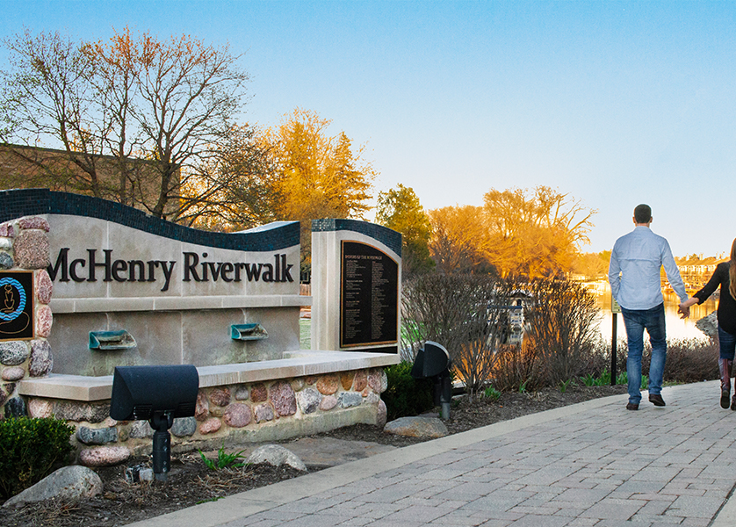
First Step: What to do with HOME-ARP?
How did we come to conclusions about what to do with HOME-ARP and how to secure other federal funding?

Slide 14
Start with what we DID NOT want to use HOME-ARP for
Tenant-Based Rental Assistance – the County’s ERA Programs were set up as a system that could achieve almost the same results
Homeless Shelter – The County completed the renovation of a site for a new homeless shelter in 2020
Homeless Shelter to Rental Conversion – in early feedback sessions with stakeholders, there was confusion about the moniker of “shelter” in conveying the use of funds and the long-term goals
Acquisition of a motel site – one site was identified, but the general thought was that it would need to be an SRO to be effective

Slide 15
Next, identify what we did want to do
Affordable housing delivery was the way to go
Would allow for either Acquisition and Rehab or Construction
Application would be rolled our to allow projects to come forward
Applicants would present to the Community Development and Housing Grant Commission
Interest identified helped to form the HOME-ARP Plan, a transparent process that would entail applicants were aware this would be approved at a later time

Slide 16
Finally, assign the HOME-ARP plan development to the team
Key lead Brandon Kyker worked to develop the plan with Planning Consultant
Plan development involved one-on-one consultations with stakeholders
Plan also involved open meetings and citizen participation
Stakeholders and citizens were advised of projects recommended for support
Plan expected to be approved in July, 2022 by the County Board

Slide 17
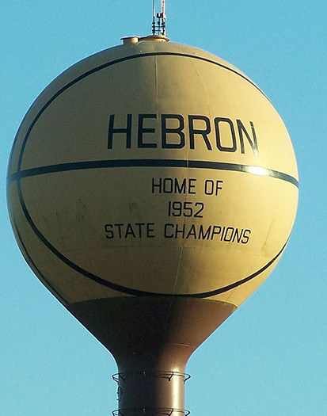
Second Step: Advocating for Other Federal Resources
How did we overcome the challenges of needing additional funding?
There has been a great deal of interest from multiple parties for a part of the $59.7M in County-ARPA funds
The County did not receive ARP Housing Vouchers, nor earlier allocations made to Counties over 500,000

Slide 18
What to do? Advocate!
CD Team reviewed County-ARPA funding bill in order to gain awareness of eligible activities
A series of concepts was sent over to the County Administration office
Affordable housing and subsidy support for CDBG Infrastructure projects were part of the recommendations
Awareness of the local subsidies was conveyed to Commission, Board Members, and County Administration
Advocacy was made in the designation of the City of McHenry being a target area for tax credits from the State, which improved eligibility for 2 of 3 projects

Slide 19
McHenry County Housing Authority
Community Development office has excellent relations with its local Housing Authority
Advocacy for MCHA to receive ARPA funds for new office
County works with MCHA for the roll out of the ERA funds
County and other potential developers have advocated for the use of Housing Vouchers for projects, which improves viability of projects long-term
It is anticipated that vouchers will be involved in 2 of the 3 projects

Slide 20
Results of Advocacy?
Anticipation of $2,500,000 in County-ARPA funds toward two affordable housing developments
12-16 Housing Choice Vouchers to assist with subsidy support for two affordable housing developments
Anticipation of having CDBG PY 2023 funds more targeted toward affordable housing (clearance and utilities)

Slide 21
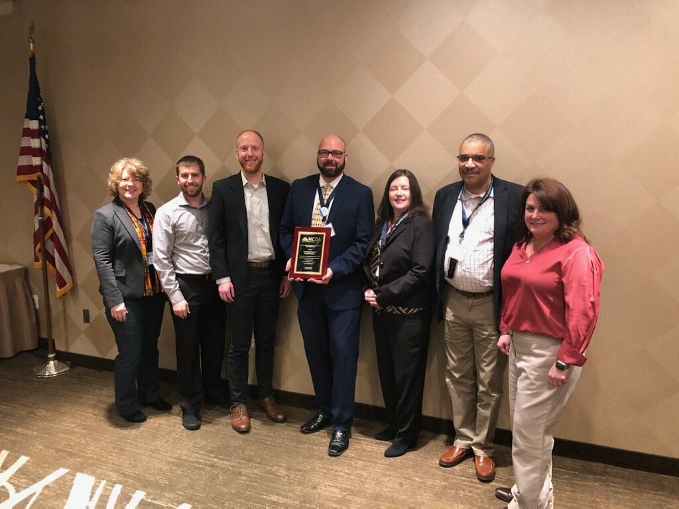
So what does McHenry County expect to achieve?
It is anticipated that three projects will be developed using federal resources, which would include a combination of tax credits, State PSH funds, HOME-ARP, CDBG, Local Utility Company support, County-ARPA funds
Seen to the left is the acceptance of the Audrey M. Nelson Award for Pearl Street Commons Phase 1

Slide 22
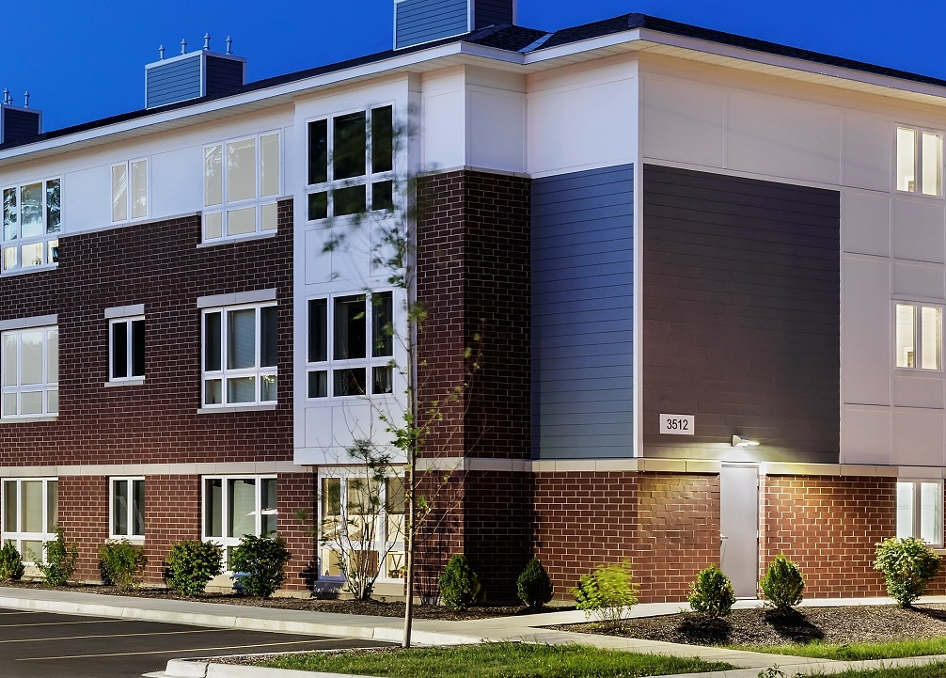
Pearl Street Commons 2
25 units on existing site
HOME-ARP: $1,250,000
CDBG: $100,000
6 Project-Based Housing Vouchers
$100,000 ComEd Energy Assistance
19 PSH Vouchers from Illinois Housing Development Authority
Permanent Supportive Housing Funding
State-designated area for affordable housing due to need
City of McHenry – $8.4M

Slide 23
Woodstock Senior Housing
80 units on city-owned site
County ARPA: $1,000,000
CDBG: $200,000 2023 funds
$300,000 ComEd Energy Assistance
4% tax credit project that will be submitted to the State of Illinois
Loan(s) of $4M
TIF District Support TBD
Public land included to reduce costs
City of Woodstock – $20M

Slide 24
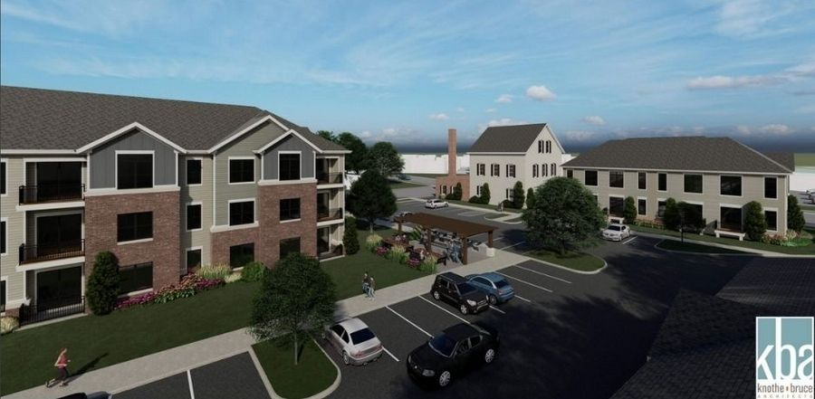
Taylor Place Apartments
54 units HOME-ARP: $1,250,000
HOME-ARP: $760,000
County-ARPA: $800,000
6 Project-Based Housing Vouchers
$200,000 ComEd Energy Assistance
State-designated area for affordable housing due to need
Historic Preservation Compenent
City of McHenry – $20M

Slide 25
Key Takeaways
Remain on top of knowing what resources might come your way – NCDA is a great resource, and this helps build rapport
Advocate for your projects/goals/objectives to leadership and stakeholders
Be open to new (but experienced) developers who express interest
If and when available, learn as much as you can about underwriting
Document, document, and more document!

Slide 26
Questions?

